Slide 1
ONLINE MEDICAL CONSULTANT SYSTEM
GROUP 2

Slide 2
About us
Supervisor:
NGUYỄN HUY HÙNG
Team Member
TRẦN NGUYÊN TIẾN SỨ
TRẦN CAO DANH

Slide 3
Agenda
Introduction
New features
Demo
Q&A

Slide 4
Introduction

Slide 5

New features
Capture webcam
View treatment history
Enable private mode
Map conversation
Search patient
Doctor
Create treatment

Slide 6

New features
View treatment history
Request consult using form
Patient
View position in waiting list

Slide 7

Scenario
Hospitalized on
01/08/2014
Su Tran
Created on
01/08/2014
Bệnh Án Ngoại Khoa

Slide 8
Scenario
First consulted on
15/09/2014
OMCS
Su Tran

Slide 9
Demo
Patient request consult using form
Doctor view treatment history
Doctor consult with patient
Doctor create treatment

Slide 10
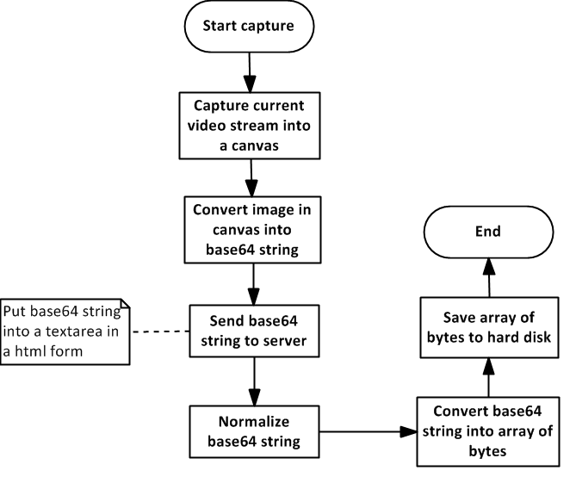
Capture webcam

Slide 11
Q&A

